Slide 1
Revision
Back to School

Slide 2
Week 12
At the Pharmacy – Pages 8 and 9 (ear and nose)
to breathe blood nose bleed runny nose/blocked nose blood pressure blow your nose | ear canal an ear infection/inflammation ear plugs ear ache ear drum (tympan) ear drops ear wax

Slide 3
Week 13
At the Pharmacy – Pages 10 (ear and nose)
Petit film sur votre pharmacie
APH 1B https://1drv.ms/u/s!AuCOpXIcvujmiaxIA-gpZYTVk2CPxw?e=VKERu4
APH 1E https://1drv.ms/u/s!AuCOpXIcvujmia8kWYfTGP8niOlDrw?e=HUFfDu

Slide 4
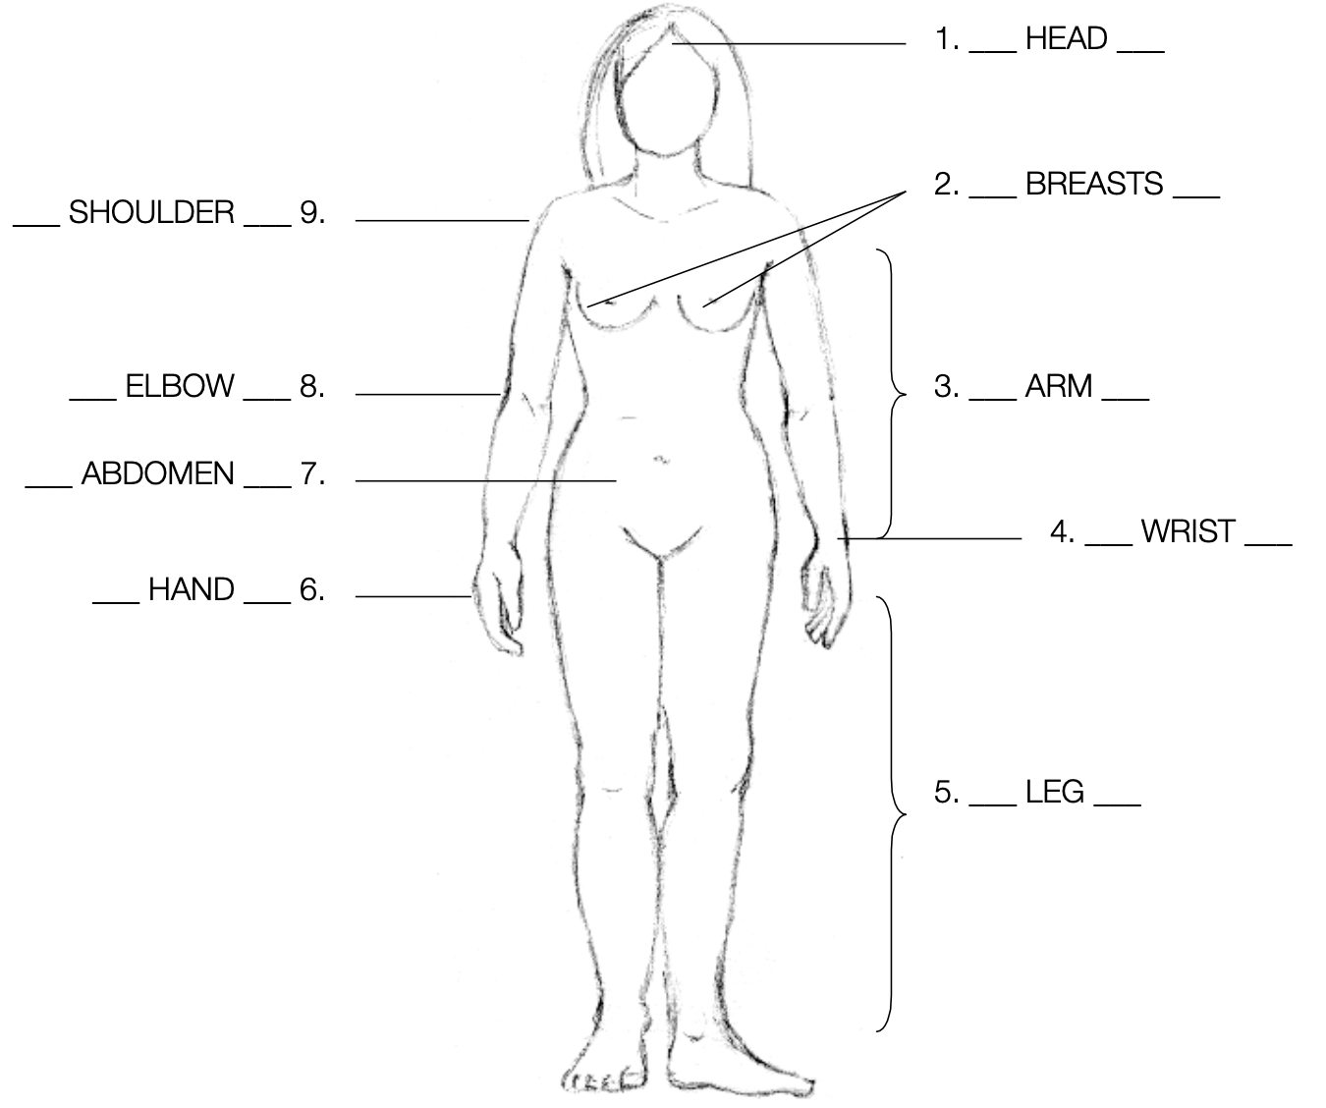
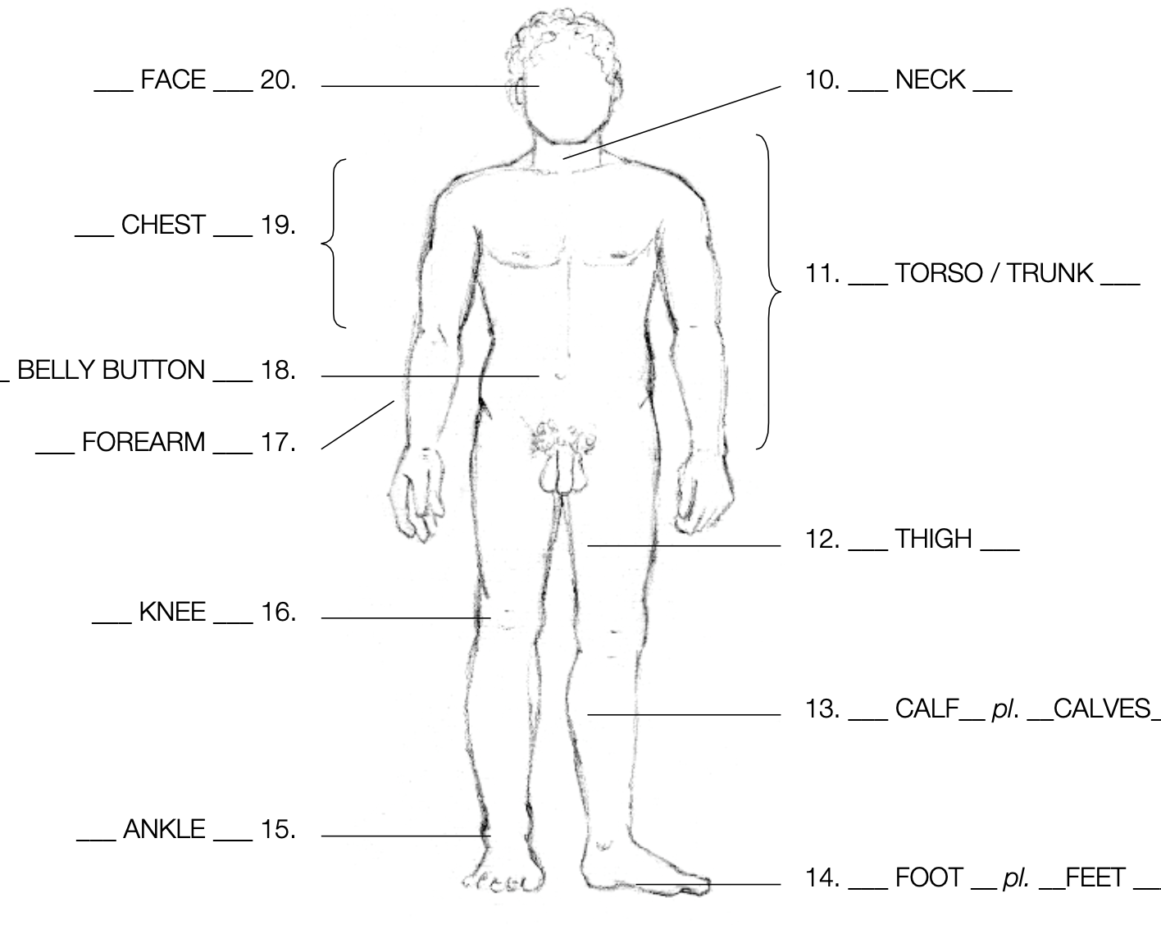
Week 14
At The Pharmacy – Page 15/16/17 (Main Body parts, limbs, joints)

Slide 5
Week 14 (suite)
Vocabulary
the spine spinal injury spinal cord vertebra the back the armpit the waist break/broke/broken | hip hipbone the pelvis upper/lower back shoulder plate navel buttocks

Slide 6
Week 18
At The Pharmacy – Page 18 (Main Body parts, limbs, joints)
aspirin
sore throat
stomach ache
faint
cough medicine
dizzy
toe
At The Pharmacy – Page 19 (Activities/tasks/duties)

Slide 7
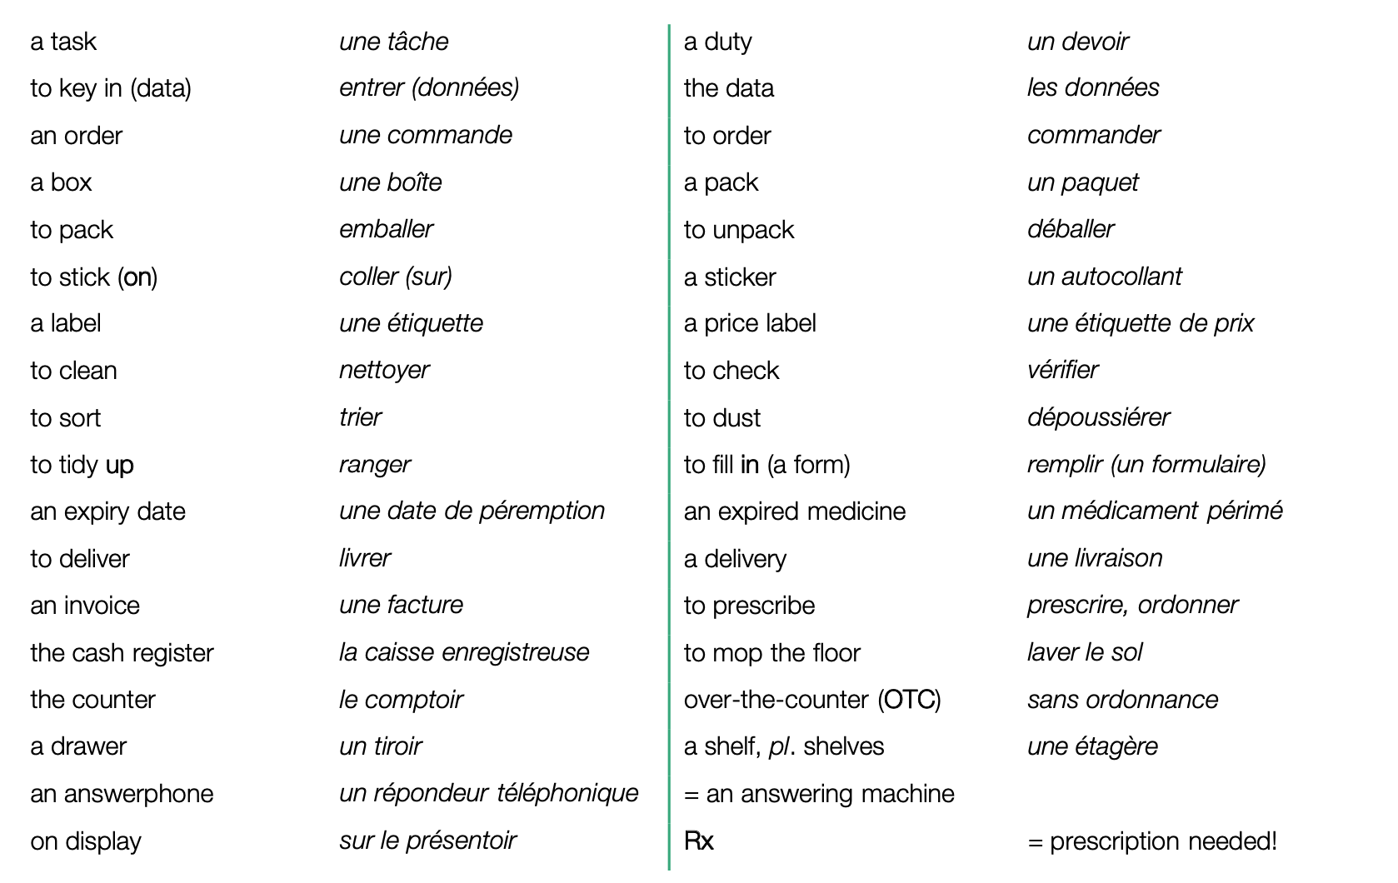
Week 18 (suite)
At The Pharmacy – Page 19 (Activities/tasks/duties)

Slide 8
Week 19
L’apprenti colle les étiquettes de prix sur les médicaments et les range dans les tiroirs. The apprentice sticks price labels on the medicines (medications, drugs) and tidies them up in the drawers.
Combien de boîtes d’anti douleurs y a t-il? – Il n’y a en pas beaucoup ! How many boxes of painkillers are there? - There aren’t many
Nous trions toujours les médicaments périmés. We always sort (out) expired medicines (medication, drugs).
A quelle fréquence est-ce que vous livrez les médicaments chez les clients? How often do you deliver medicines at/to the clients’ (home)?
Je lave rarement le sol mais je dépoussière souvent les étagères. I hardly ever mop the floor but I often dust the shelves.
Ma tâche quotidienne est de déballer la commande. My daily task is to unpack the order.
Les produits en action sont sur un présentoir à côté du comptoir et de la caisse enregistreuse. The products on sale are on a display, next to the counter and the cash register.
L’apprenti vérifie les médicaments sans ordonnance.
The apprentice checks the over-the counter medication/medicine (OTC).
As-tu vérifié la date de péremption des gouttes pour le nez ? Have you checked the expiry date of the nose drops?
Je n’aime pas rentrer les données dans l’ordinateur mais j’adore remplir les formulaires I don’t like keying in data into the computer but I love filling in forms.

Slide 9
Week 19
At The Pharmacy – Page 20 (Activities/tasks/duties)
The Effects of Stress (comprehension)
tights (UK) / pantyhose (US) stockings to support to need to come in (do they come in red)? | socks support stockings

Slide 10
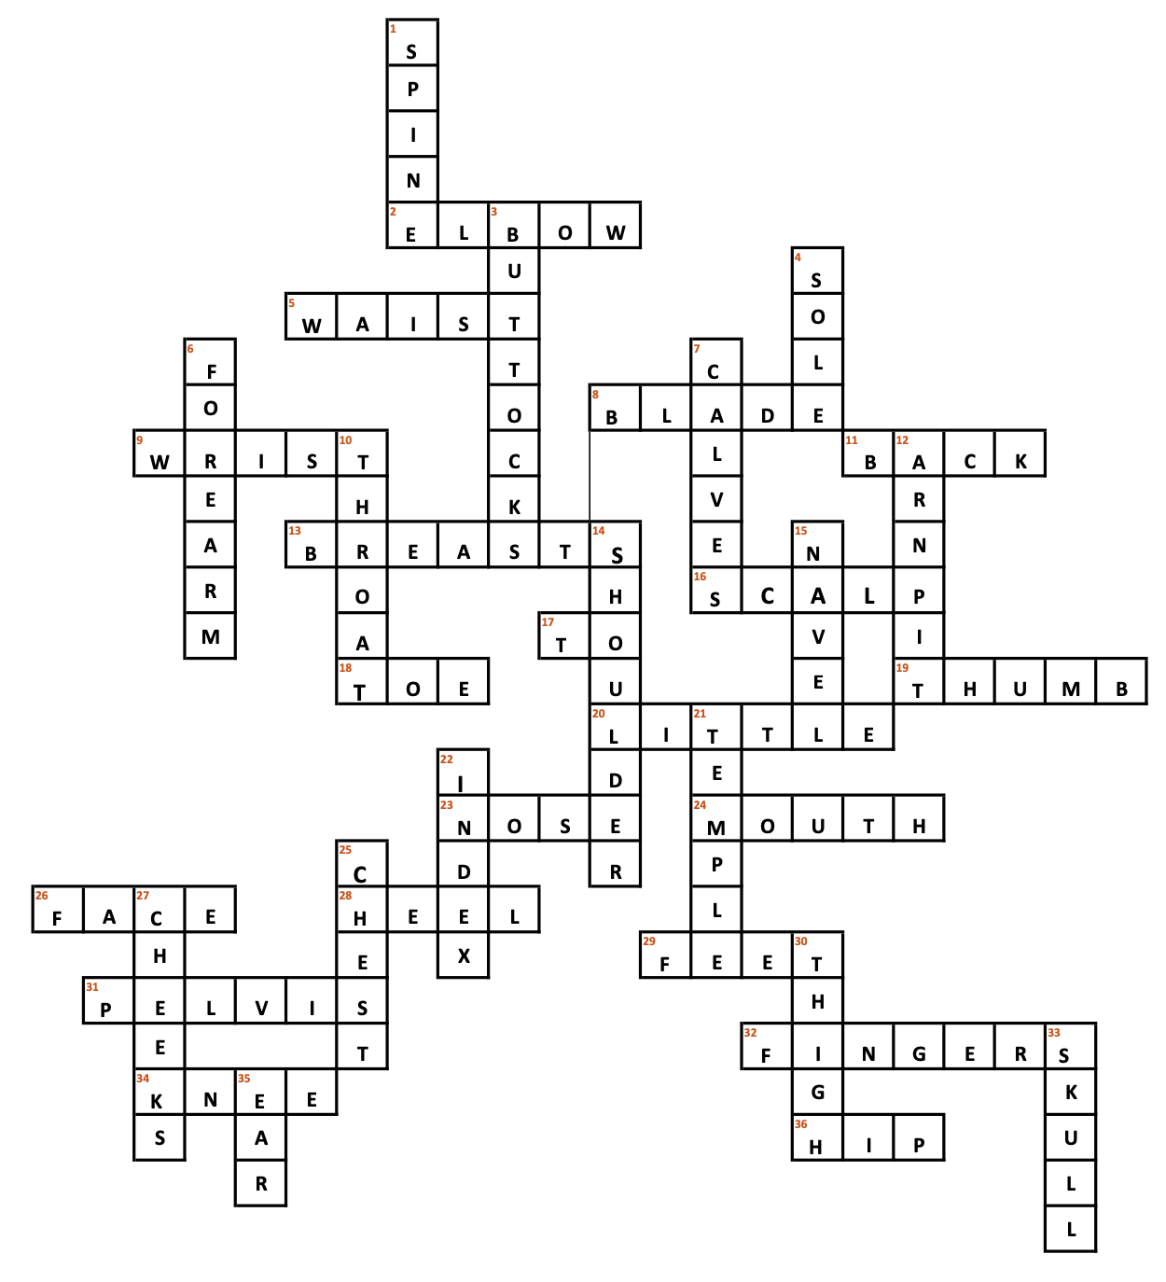
Week 20
At The Pharmacy – Page 21 (Activities/tasks/duties)
to advise the customers
to use the cash register
to fill in a form
to have a break
to recommend a generic
to check for outdated products
WHO (comprehension)

Slide 11
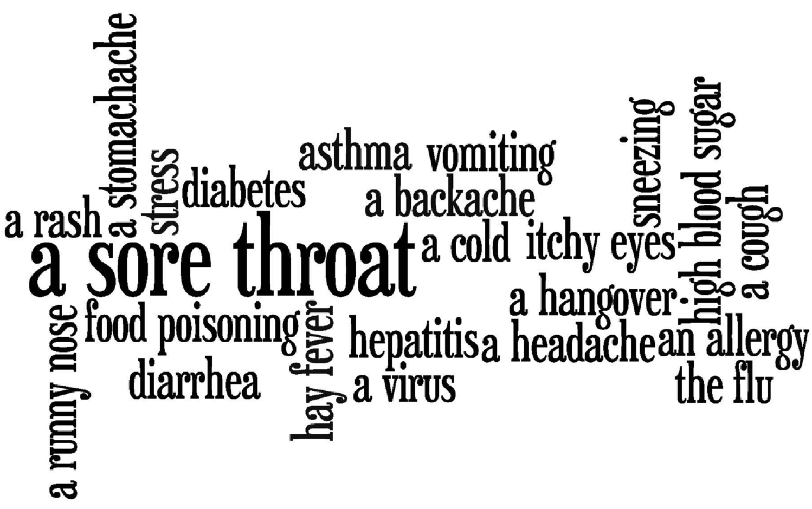
Week 22
Compréhension de Lecture
Reading Comprehension - Left and Right Brainpower
Compréhension Auditive
British Council – At the Chemist
Vocabulary
Illnesses and Symptoms
Gap Fill
Mots Croisés

Slide 12
Week 23
New Headway Grammar Revision First Year

