Slide 1
Revision
Back to School

Slide 2
Week 12
New Headway Elementary Chapter 4 – Page 48
And (et), So (ainsi, alors), But (mais), Because (parce que)
Irina and Pavel are hungry so they go to the Kebab. But the Kebab is closed because of Covid so they go to McDonals.
Compréhension (vidéo)
A home away from home (différents types de maisons)

Slide 3
Week 13
Some and Any
Some pour phrases positives
I have some chocolates in my bag.
Any pour phrases negatives ou questions.
I don’t have any friends. :-(
Do you have any money?
Somebody/Anybody/Nobody
I know somebody who is more beautiful than I am
I don’t know anybody who can eat as much chocolate as I
Nobody is richer than me.
Compréhension auditive – Shopping in GB.

Slide 4
Week 14
Compréhension de lecture (Reading_GCD_Shopping Clothes)
Can and Can’t
I can swim. You can’t dance on the tables
Comment se présenter

Slide 5
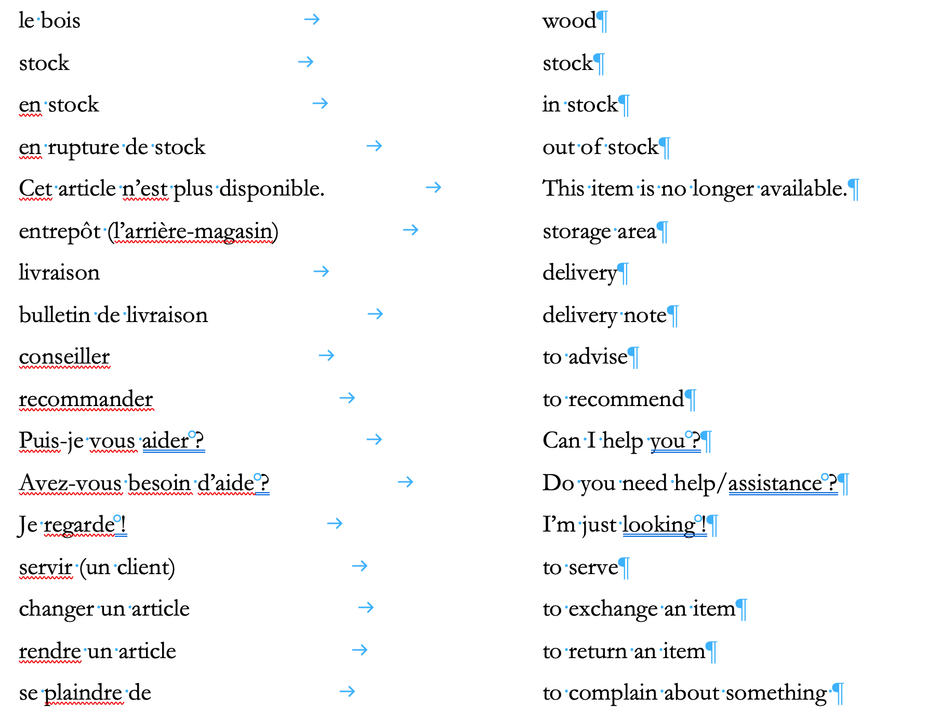
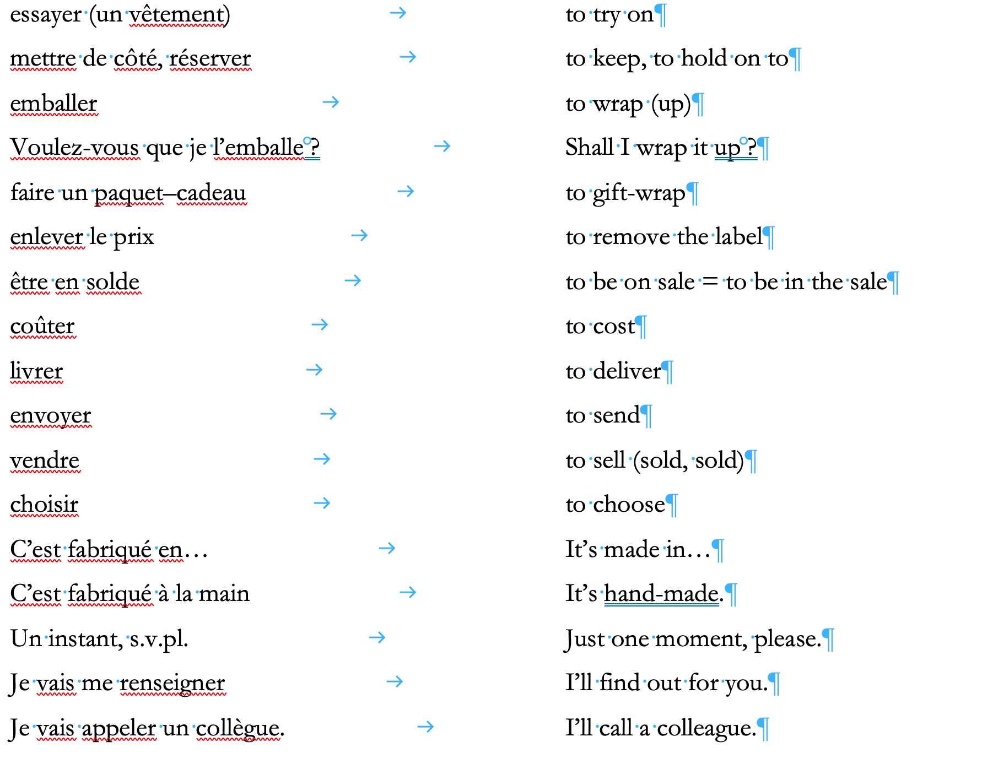
Week 14 (suite)
Apprendre le vocabulaire professionnel (pages 3 et 4)

Slide 6
Week 18
New Headway SB Elementary - Chapter 5 – Page 51
can / can’t
I can speak Swiss German, you can’t speak Swiss German
New Headway SB Elementary - Chapter 5 – Page 55
talented
normal
proud
brilliant
rich
”cool”
full time
expensive
successful
old

Slide 7
Week 19
New Headway SB Elementary - Chapter 5 – Page 52/53
WAS – WASN’T / WERE – WEREN’T
Yesterday I was in Lausanne
You were in bed at 7 pm last night
They weren’t in Mallorca this year
I wasn’t happy when school started
COULD
I could swim when I was nine
I couldn’t drive a car when I was nine

Slide 8
Week 19 (Suite)

Slide 9
Week 20
New Headway SB Elementary - Chapter 5 – Page 56
Vocabulary – Mots composés
noun + noun
police woman
car park
traffic light
verb + noun
speak a foreign language
watch films online
live on the third floor

Slide 10
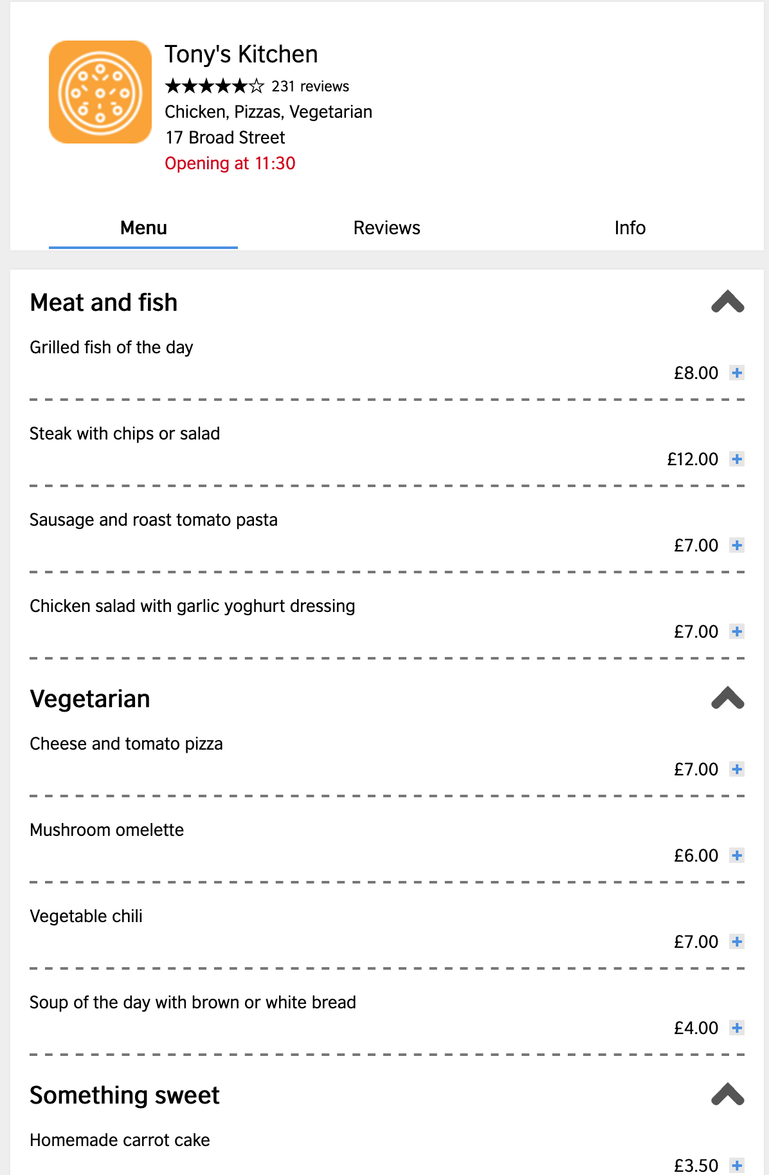
Week 20 (Suite)
British Council – Restaurant Menu
https://learnenglish.britishcouncil.org/skills/reading/beginner-a1/a-restaurant-menu

Slide 11
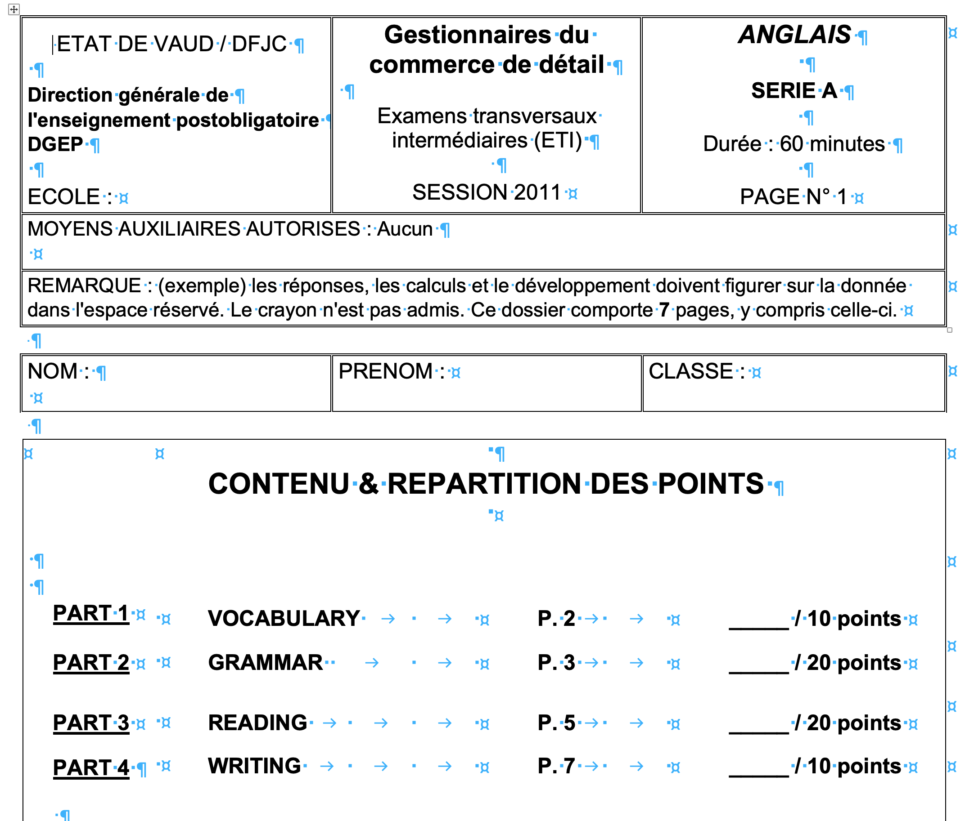
Week 22
ETI GCD 2011

Slide 12
Week 23
New Headway Grammar Revision First Year

